Slide 1

Detection of Common Ear Diseases in the Community (Part 2)

Slide 2
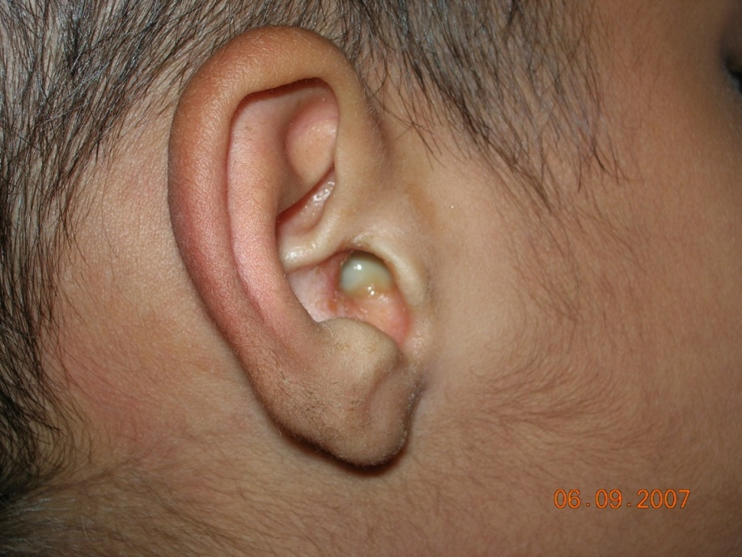
Discharging ear: Chronic ear infection
Chronic Ear infections will/may lead to:
Discharge from the ear
Perforation of ear drum
Decreased hearing
At times, it can cause fever, giddiness, serious complications

Slide 3

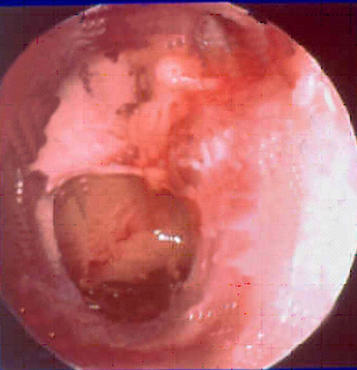
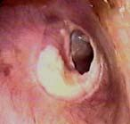
Findings on examination
Notes:
The TM pics are just to stress the problem. The MPWs are not going to be able to see the TM as they are neither trained for that nor do they have the necessary equipment. They must be told that they must refer any child with ear discharge for check up and treatemnt as this can be the status of the TM

Slide 4
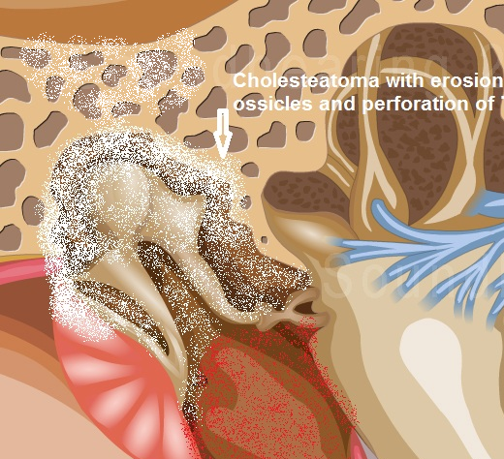
Un- Treated Chronic ear infection
Clinical Features of complications:
Vertigo, vomiting
Headache, fever
Swelling around ear
Facial paralysis
Untreated, CSOM may lead to serious life-threatening complications such as Meningitis, Intracranial abscess
Also, Facial paralysis, Labyrinthitis(vertigo), Mastoiditis etc
Notes:
The image on this slide depicts the presence of a cholesteatoma in the middle ear. The cholesteatoma can lead to erosion of the bony walls and spread to surrounding structures. This results in development of complications such as meningitis, brain abscess etc.

Slide 5
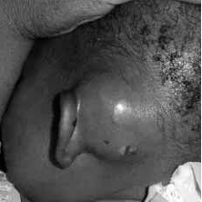
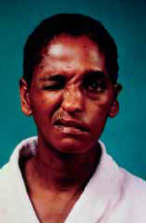
Common Complications

Slide 6
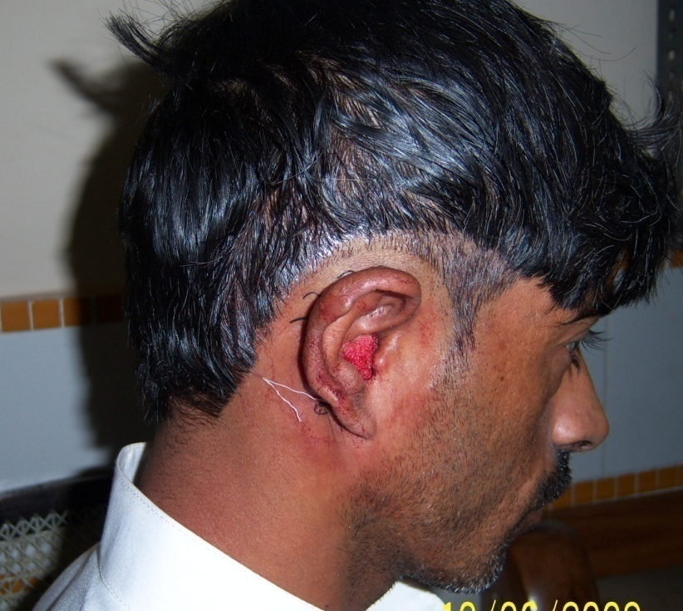
Treatment of CSOM
Most patients with Chronic discharge from the ear are likely to require surgical treatment.
Ask the parent to take the child
to an ENT doctor for assessment,
hearing tests and surgery.
Notes:
Tell them that although almost all patients require surgery, there are various factors to be taken into consideration while planning that surgery. It is important to start the medical treatment so that the ear can be kept dry and disease free till the surgery is awaited. All patients with Discharging ear MUST be seen by the doctor or the ENT specialist.

Slide 7
Instructions to be given to a patient with CSOM
Notes:
Inform the trainees that wile that it is important to go to an ENT doctor for any discharging ear. Also, there are certain important precautions that they must take. You must give the patient/parent proper instructions to folow in this regard. These instructions mainly relate to:
Keeping the ear dry
Aural toilet: Cleaning the ear
Instilling Ear drops: ear drops as advised by the doctor must be instilled properly. The technique for this is outlined here.
In case of small babies who are breast fed or bottle fed, it is important to maintain proper posture while feeding the child.

Slide 8
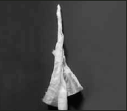
Instructions to be given to a patient with CSOM
KEEP EAR
DRY
AURAL
TOILET
EAR
DROPS
FEEDING
POSTURE
Wicking:
Use a small piece of absorbent cloth or a piece of STRONG tissue paper
Wash hands
Roll the cloth/paper into pointed shape
Straighten the canal by pulling the pinna
Place the wick in the ear canal.
Leave until wet
Remove & replace with clean wick.
Repeat till wick remains dry.
Notes:
The image on this slide is of a wick which can be used to clean the ear canal.

Slide 9
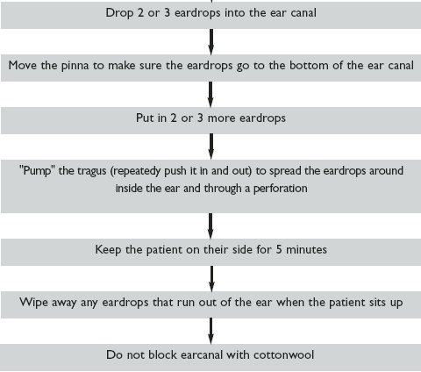
Instructions to be given to a patient with CSOM
KEEP EAR
DRY
AURAL
TOILET
EAR
DROPS
FEEDING
POSTURE
METHOD
Notes:
Stress to the trainees that the ear drops must be used only as advised by a health care worker/doctor (as is appropriate for the country/region). Outlined here is the method of using ear drops. It does not imply that all patients require or will benefit from use of ear drops.

Slide 10
Instructions to be given to a patient with CSOM
KEEP EAR
DRY
AURAL
TOILET
EAR
DROPS
FEEDING
POSTURE
PROPER POSTURE: Whenever the baby is Breast or Bottle fed, it is essential to maintain the proper feeding posture so that the regurgitation of milk into the middle ear through the Eustachian tube can be avoided.
Notes:
Posture while feeding is important in a bottle/breast fed baby. The baby should be held with its head in an elevated position to prevent regurgitation of milk into the ear through the eustachian tubes.

Slide 11

Thank You

